Slide 1
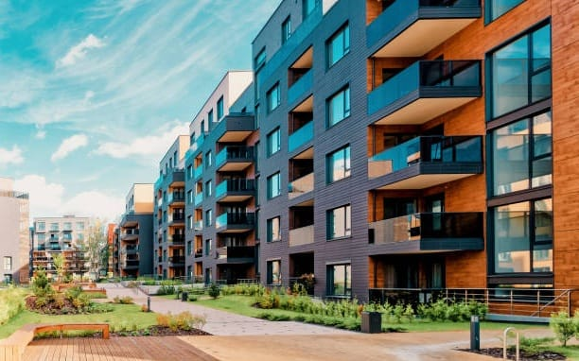
APARTMENT MANAGEMENT SYSTEM

Slide 2
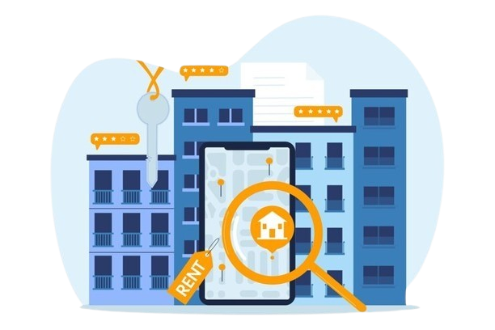
Problem Statement:
Develop a streamlined Apartment Management System (AMS) to enhance the management processes of a residential complex. The AMS should have the details of residents residing in the apartment. It should be user-friendly, scalable, secure.

Slide 3
OBJECTIVES
Enhancement:
The main objective of apartment management system is to enhance and upgrade the existing system by increasing its efficiency and effectiveness. The software improves the working methods by replacing the existing manual system with the computer based system.
Automation:
The Apartment management system automates each and every activity of the manual system and increases its throughput. Thus the response time of the system is very less and it works very fast.
User-Friendly:
The system apartment management system has a very user-friendly interface. Thus the users will feel very easy to work on it. The software provides accuracy along with a pleasant interface. Make the present manual system more interactive, speedy and user friendly.
Availability:
The transaction reports of the system can be retried as and when required. Thus, there is no delay in the availability of any information, whatever needed, can be captured very quickly and easily.

Slide 4
OBJECTIVES
Enhancement:
The main objective of apartment management system is to enhance and upgrade the existing system by increasing its efficiency and effectiveness. The software improves the working methods by replacing the existing manual system with the computer based system.
Automation:
The Apartment management system automates each and every activity of the manual system and increases its throughput. Thus the response time of the system is very less and it works very fast.
User-Friendly:
The system apartment management system has a very user-friendly interface. Thus the users will feel very easy to work on it. The software provides accuracy along with a pleasant interface. Make the present manual system more interactive, speedy and user friendly.
Availability:
The transaction reports of the system can be retried as and when required. Thus, there is no delay in the availability of any information, whatever needed, can be captured very quickly and easily.

Slide 5
OBJECTIVES
Enhancement:
The main objective of apartment management system is to enhance and upgrade the existing system by increasing its efficiency and effectiveness. The software improves the working methods by replacing the existing manual system with the computer based system.
Automation:
The Apartment management system automates each and every activity of the manual system and increases its throughput. Thus the response time of the system is very less and it works very fast.
User-Friendly:
The system apartment management system has a very user-friendly interface. Thus the users will feel very easy to work on it. The software provides accuracy along with a pleasant interface. Make the present manual system more interactive, speedy and user friendly.
Availability:
The transaction reports of the system can be retried as and when required. Thus, there is no delay in the availability of any information, whatever needed, can be captured very quickly and easily.

Slide 6
OBJECTIVES
Enhancement:
The main objective of apartment management system is to enhance and upgrade the existing system by increasing its efficiency and effectiveness. The software improves the working methods by replacing the existing manual system with the computer based system.
Automation:
The Apartment management system automates each and every activity of the manual system and increases its throughput. Thus the response time of the system is very less and it works very fast.
User-Friendly:
The system apartment management system has a very user-friendly interface. Thus the users will feel very easy to work on it. The software provides accuracy along with a pleasant interface. Make the present manual system more interactive, speedy and user friendly.
Availability:
The transaction reports of the system can be retried as and when required. Thus, there is no delay in the availability of any information, whatever needed, can be captured very quickly and easily.

Slide 7
SEARCH
DELETE
ADD
Retrieve specific data from the table
Enables to add a new resident and enter the details of the resident
Removes one or more rows from the table based on specified conditions
FUNCTIONS
UPDATE
SHOW ALL
CLEAR
Update is used to modify one or more columns in a table
Displays all data in the table
Removes all rows in the table

Slide 8
DELETE
SEARCH
ADD
Removes one or more rows from the table based on specified conditions
Retrieve specific data from the table
Enables to add a new resident and enter the details of the resident
UPDATE
CLEAR
SHOW ALL
Update is used to modify one or more columns in a table
Removes all rows in the table
Displays all data in the table

Slide 9
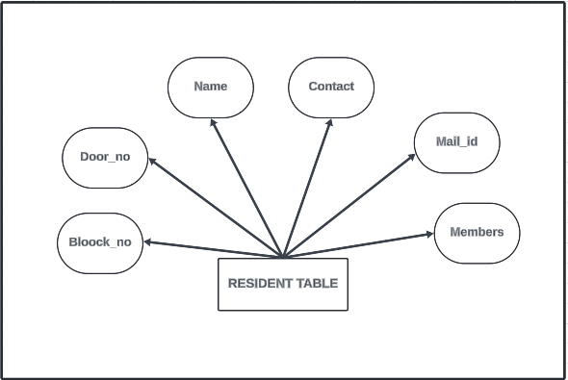
ER DIAGRAM

Slide 10
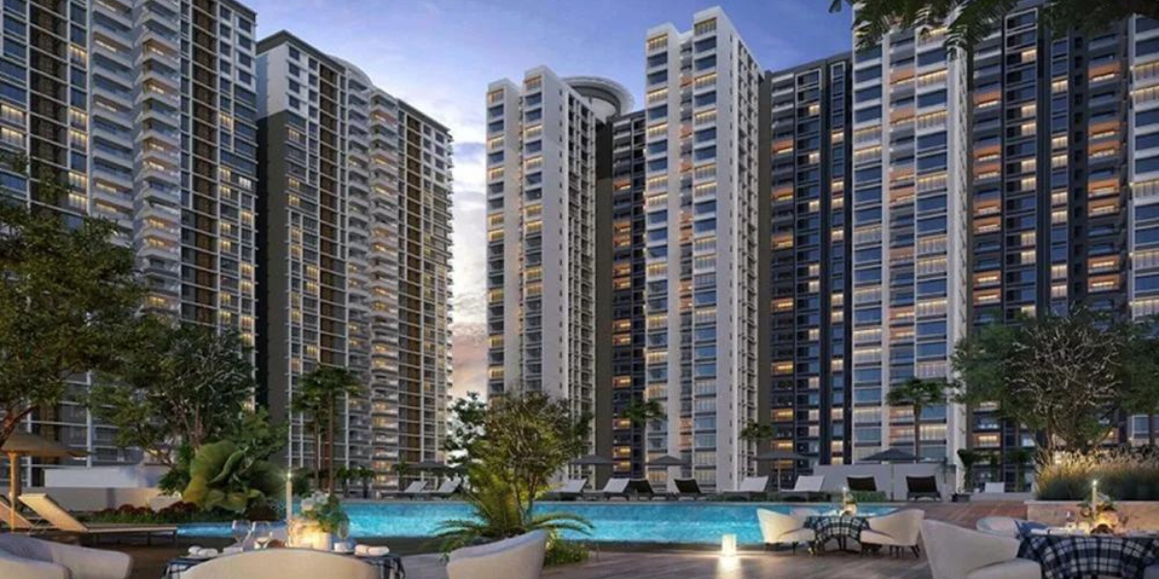
Python
Python serves as the primary
programming language for
Building the application logic,
backend functionality, and GUI.
TECHNOLOGY STACK
GUI Framework
Tkinter: Tkinter is a standard GUI toolkit for Python. It's lightweight, easy to use, and comes bundled with Python installations, making it a good choice for simple GUI applications
MYSQL
Stores data: apartments, tenants, bookings, bills. Retrieves specific information. Modifies data: adding, updating, deleting. Maintains data integrity and security. Analyzes data for insights. Facilitates maintenance tasks.

